Slide 1
MOBILE STORE SALES
By Sai Vineeth Karakavalasa (Data analyst in TCS)

Slide 2
PROBLEM STATEMENT
Vinay is Owner of a Mobile store .He wants to create a performance dashboard in order to get the Business insights out of it.
He has given the Dataset which includes the data related to RAM, ROM, Number of cameras, Processor, Ratings, Sales, Sales price, Discount for different Mobile brands in Respective years.
Vinay wants the Business analyst to create dashboard where he can fetch data of the following by filtering with year and mobile brand. CR1- Visualization with count of models under a particular brand and year. CR2- Visualization with sales price under a particular brand. CR3- Visualization of mobiles with different screen sizes and their count under a particular brand and year. CR4- Visualization of sales of mobilebrands. CR5- Visualization with ratings of mobiles. CR6- Visualize total sales, total mobiles, Mobile with highest and lowest price.

Slide 3
ANALYZING THE CLIENT REQUIREMENTS
We need to closely observe the data set for all the columns and data inside it is proper.
Based on the client requirements, we need to Predict which visualizations to use.
CLIENT REQUIREMENTS | VISUALIZATIONS
CR1 | Pie Chart
CR2 | Donut chart
CR3 | Area chart
CR4 | Column chart/Bar graph
CR5 | Column chart/Bar graph
CR6 | Card

Slide 4
LOADING DATA SET
After analyzing the data, We can take the data from given data source with “Get data” icon in power query or we can use “Transform data” icon also to load the data.
We can filter out the useless data from the data source in the power query .
We can also Change data types of columns as per requirement. If the first row of the data set is not loaded as header , we can manually make the first row as headers.
Initially in Power query, the transformations and Changes we applied on a data set will be applied only on first 1000 rows. But once we hit “ Close and apply” It will bring complete data and loads transformed data into power pivot.

Slide 5
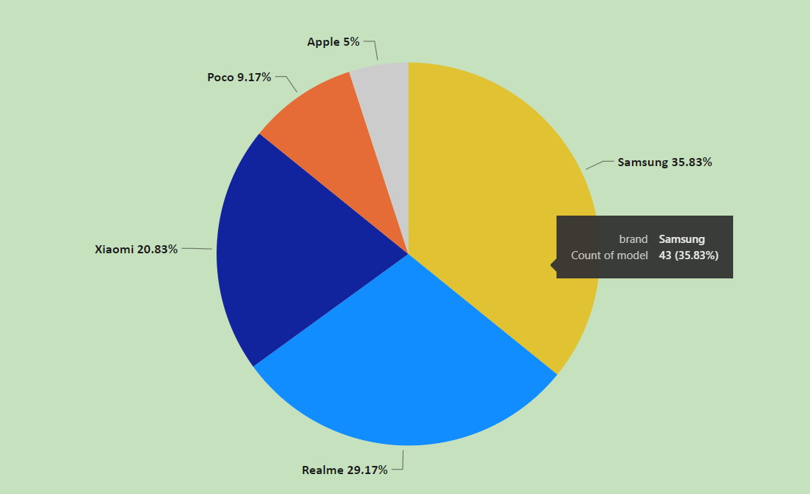
CLIENT REQUIREMENT-1
Visualization with count of models under a particular brand and year.
This can be created using a pie chart where we can visualize the count of different models and their share (Percentage) of the count.

Slide 6
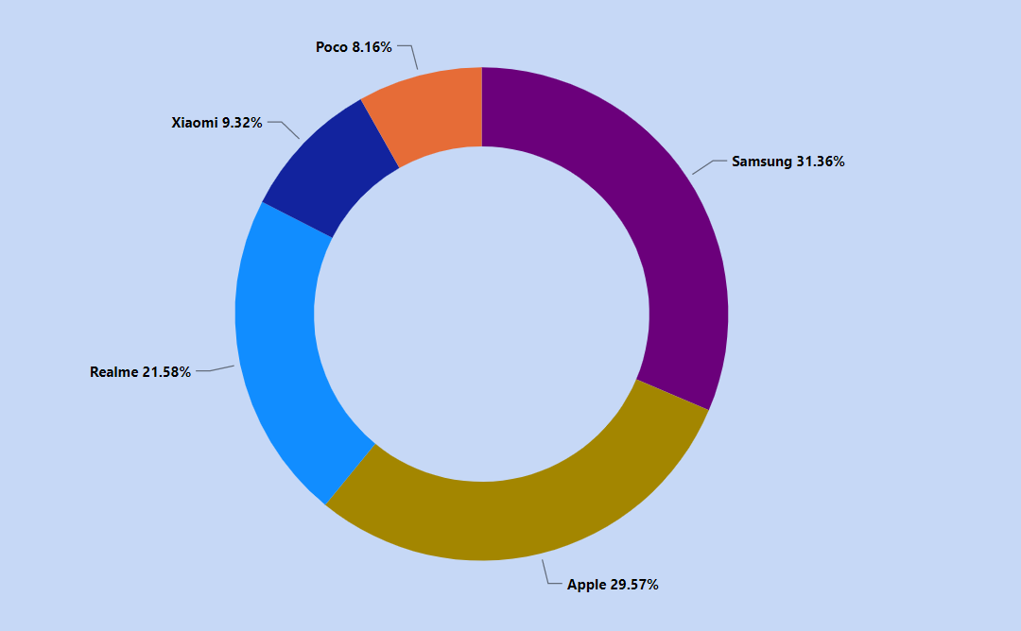
CLIENT REQUIREMENT-2
Visualization with sales price under a particular brand.
This pictorial representation shows the sales price of all the brands and giver overview of how much share each brand has out of total sales.

Slide 7
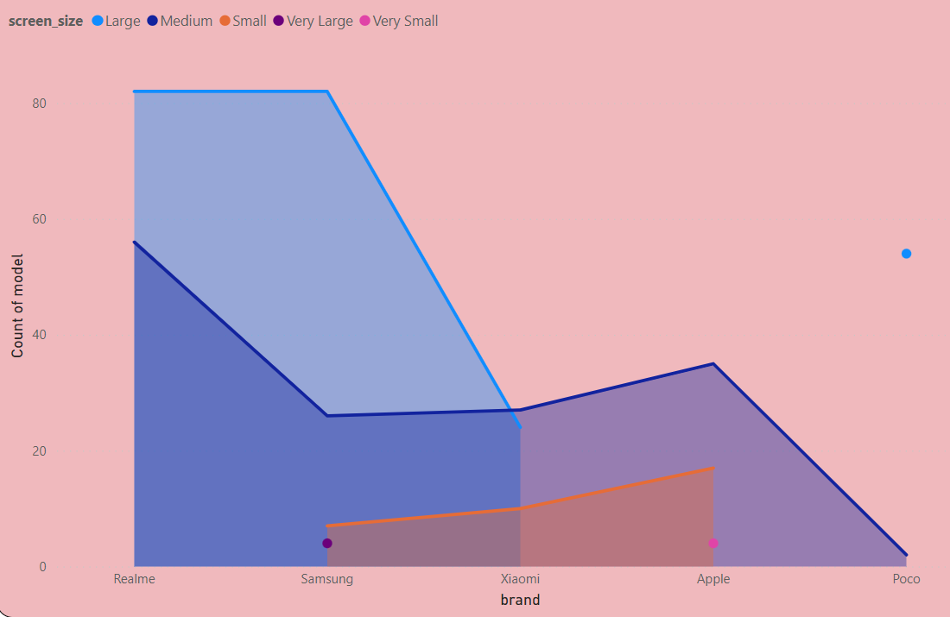
CLIENT REQUIREMENT-3
Visualization of mobiles with different screen sizes and their count under a particular brand and year.
Here three measures- Count of model, brand and screen size are used for this visualization. If more measures were involved we can prefer tree map.

Slide 8
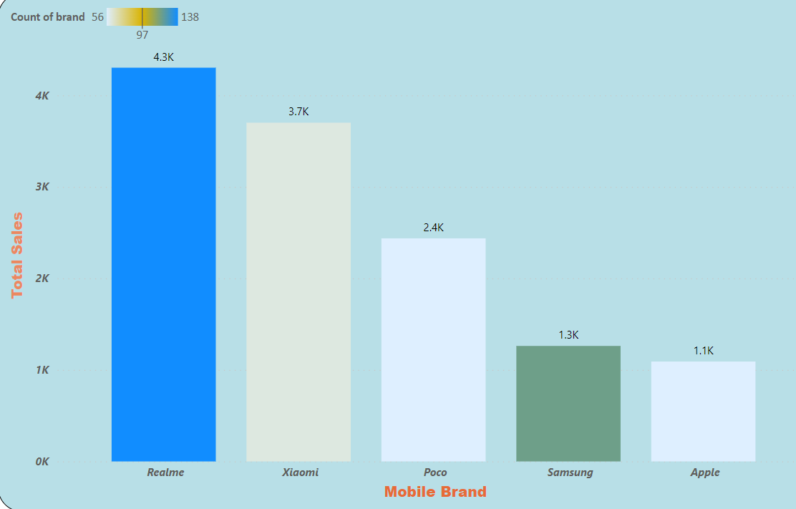
CLIENT REQUIREMENT-4
Visualization of sales of mobilebrands.
This is a stacked column chart visual in Power BI with Total sales on Y-axis and Mobile brand on X-axis.

Slide 9
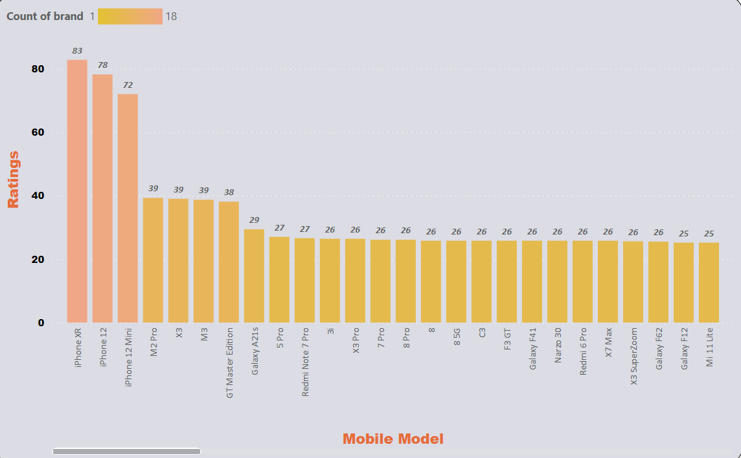
CLIENT REQUIREMENT-5
Visualization with ratings of mobiles.
This is a stacked column chart visual in Power BI with Ratings on Y-axis and Mobile model on X-axis.

Slide 10
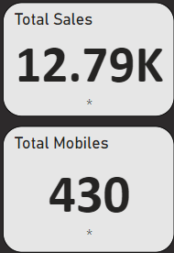
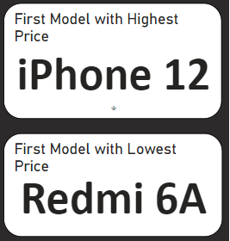
CLIENT REQUIREMENT-6
The visuals for Total sales ( sum of sales) , Total mobiles (count), Highest price model and Lowest price model were displayed via card visuals in {Power BI.

Slide 11
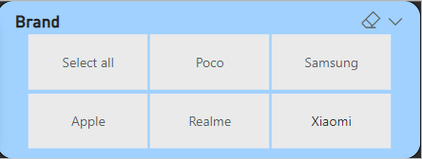
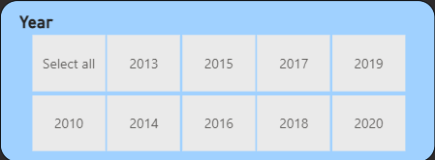
ADDING SLICERS TO THE DASHBOARD
Slicers are used for displaying commonly used or important filters on the report canvas for easier access.
Slicers can be used in two modes- Horizontal and Vertical.
Here slicer 1 is used to filter based on brand of the mobiles and slicer 2 is used to filter visualizations based on year.

Slide 12
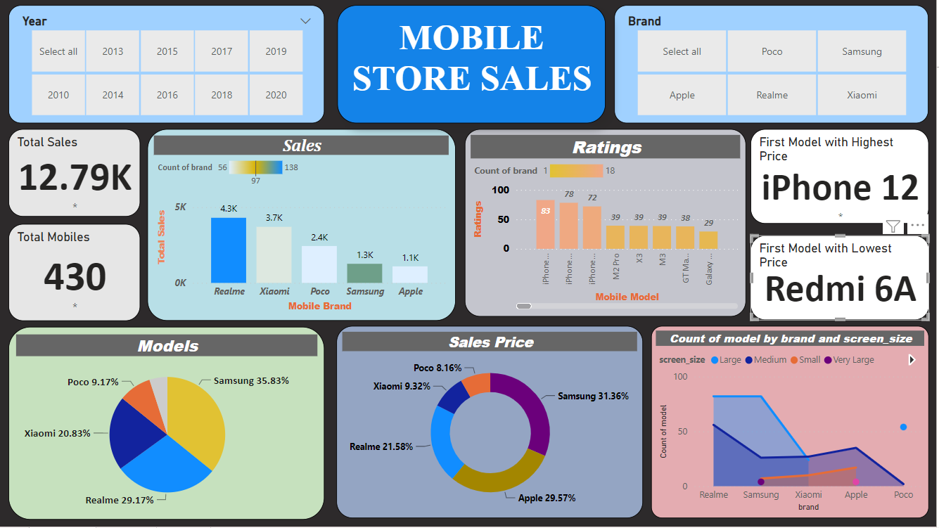
FINAL PERFORMANCE DASHBOARD

Slide 13
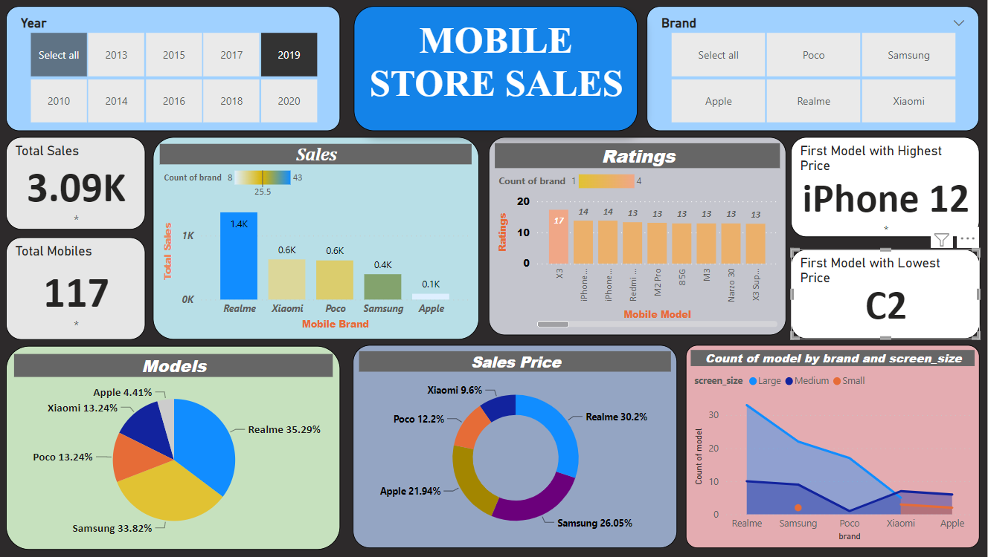
DASHBOARD FILTERED WITH YEAR
Here we have selected 2019 year. So dashboard visualizes data with 2019 year

Slide 14
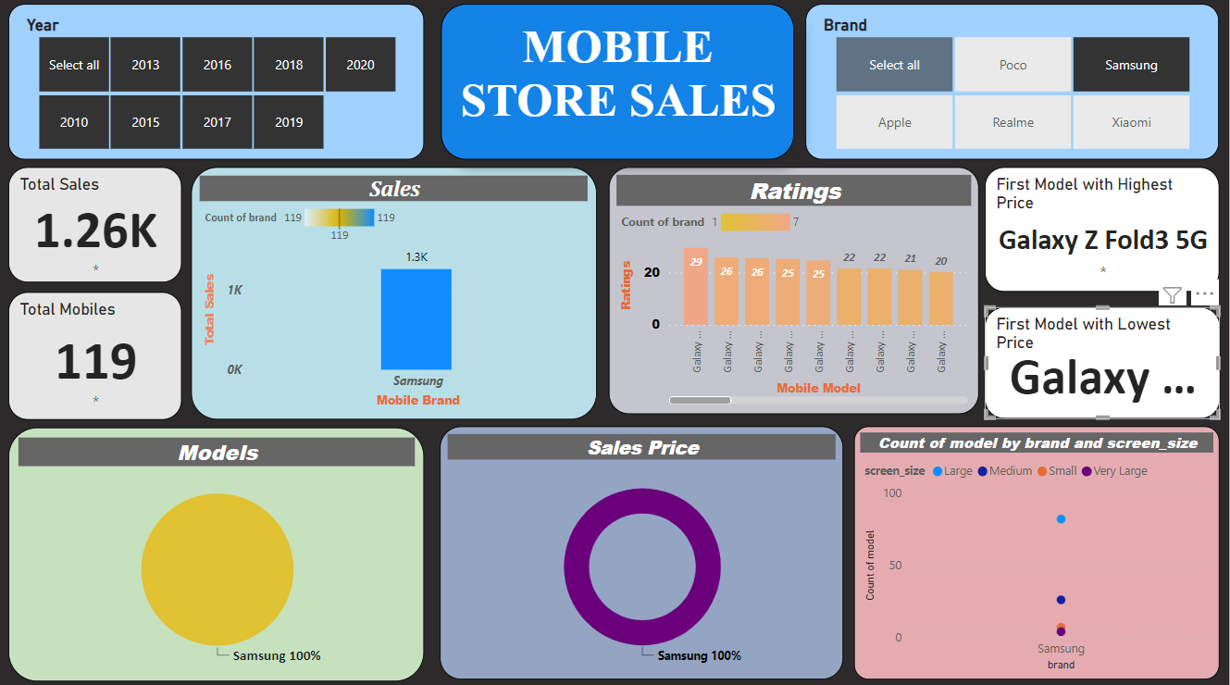
DASHBOARD FILTERED WITH BRAND
Here we have selected Samsung Brand. So dashboard visualizes data with Samsung brand.

Slide 15
CONCLUSION:
So the Client Requirements (CR1 To CR6) were accomplished with the created performance dashboard.
Client can make good business insights out of it and helps in taking good business development decisions.
We have created a good Performance dashboard including all required KPI’s.
Proper alignments and rounded corners to the visuals also made the Dashboard visually impactful.
We have made this dashboard user friendly by creating slicers and filtering the required visuals.
A SATISFIED CUSTOMER IS THE BEST BUSINESS STRATERGY OF ALL

Slide 16
THANK YOU

